Slide 1

Reviewing Fake News Detection on Social Media using Geometric Deep Learning
Group 4
Group 4

Slide 2
Problem Statement
Addresses Fake News Detection on Social Media using methods of Geometric Deep Learning.
Find robust mechanism of detecting fake news as a means of countering propaganda and disinformation campaigns
Mechanisms to be developed should be independent of features like language, locales, geography etc.
Developed method is robust enough to remain unaffected by manipulation from external sources and adversarial attacks.
To be ensured that the method ages well over time, and works even after long periods of time after training.

Slide 3
Importance of the Problem
Social media playing an increasingly important role in daily lives
Rapid circulation of information, ease of use had led to it becoming the primary source of news
Increasingly important to verify information
Why? May lead to manipulation of people, cause strife in society, and even undermine principles of democracy
Few Examples
Cambridge Analytica Scandal - Voter Manipulation
Brexit Referendum
Russian Disinformation Campaigns - most recently with spreading of fake news about western vaccines
Finding a solution is important to maintain peace and harmony
Difficult to identify fake news, given how controversial the issue is, hence require a robust, relatively unbiased system to do so

Slide 4
Past Research Directions
Content Based
Rely on linguistic characteristics to capture indications that may be associated with fake news.
Language dependent which restricts their use in generic approaches.
Fake news can be labelled as true news if it’s well written and does not appear as fake at first sight.
Social Context Based
Use context features such as demographic information, social network structure including connections, friends, followers etc. and reactions by users (likes) to identify and generalise fake news sources.
Forms the inherent tri-relationship, the relationship among publishers, news pieces, and users, which has the potential to improve fake news detection.
Found to not work very well on its own.

Slide 5
Past Research Directions (contd.)
Propagation Based
Track the spread of news over time to find features distinguishing the propagation pattern of true news versus the pattern of fake news.
Based on the assumption that news spreads in a manner similar to that of infectious diseases and hence, we can use epidemic models here too.
Empirically found that the spread of fake news is different from true news.
Possibly robust to manipulation from actors spreading misinformation, since spread is not controllable by these actors.
Past approaches have focused too much on graph theoretical features while designing models which seem to be too general for the specific task of FND.

Slide 6
Major Contributions
Exploited geometric deep learning techniques to identify features to help distinguish between fake and true news
One of the few approaches to use non-Euclidean data such as graphs, to solve a real world problem
GCNNs were used to include propagation based data, working on graph structured data, incorporating heterogeneous data(such as user demographics, activity, social network structure,propagation structure and even content), hence holistic
Conjectured to be extremely robust to any kind of adversarial attacks
Proposes two approaches, one based on URL and the other based on the cascades corresponding to the URLs in tweets
Achieves a 93% ROC-AUC, even with very short spread times ( ̃2 hours of propagation)

Slide 7
Major Contributions (contd.)
Found that most credible and noncredible users have homophilic interactions, a nod to echo chamber theories
Score users based on credibility within a +1 to -1 range
Proved that propagation based features are extremely important in differentiating fake and true news
The model performs well even when the model is trained on data that is distant in time for the test data (performance degradation after ~180 days)

Slide 8
Limitations
Authenticity and accuracy of fact checkers like Snopes, PolitiFact and Buzzfeed
In 279 cases (33% of the sample), PolitiFact checks a complex proposition and assigns one truth rating to it. This isn’t accurate as some of the claims in a piece labelled false may actually be true.
When a model is trained on the data, there is a bias/error that is carried forward from the PolitiFact dataset.
The paper only classifies political tweets and not the fake news regarding scientific research, pranks and even active disinformation campaigns by actors to gain fame.
Only cascades with 6 or more tweets were used for the cascade-wise classification
The average cascade size in the dataset being used is 2.79. This led to the inclusion of 5,976 data points
The paper assumes that all cascades associated with a URL, inherit the URL label. This could be false when the particular tweet/post is denying content of the URL.
Model is too simplistic because it ignores mixed or partial true/false data, losing an important chunk of the set.
The model seems to not age well with time, with performance drops drastically after 180 days in URL wise settings, and 260 days in the case of cascade wise setting.

Slide 9
Future Research Directions
Increasing the number of categories by including partially/mostly true or false that shall let people know that this is a complex statement and hence, the model cannot label them definitively.
Since the model loses a lot of data by excluding small cascades, the model can make a hybrid of a content-based system for smaller and and propagation-based system, with robust regularization.
Experimentally verify how robust the model is to adversarial attacks.
Replicating this model for other social media platforms like Facebook. This can be done by replacing the retweet metrics with the shares, no of reacts and the number of friends associated with a post.
Explore additional applications of our model in social network data analysis going beyond fake news detection, such as news topic classification and virality prediction.
Improve interpretability of model by understanding what features contribute to the difference between true and fake news.

Slide 10
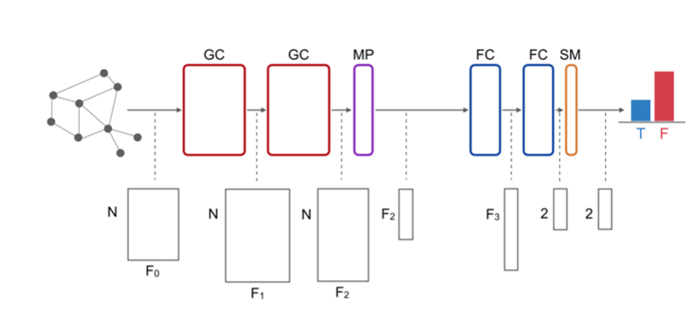
Neural Net Architecture

Slide 11
Implementation Details
The First GC₁ layer implemented in our code is the GATConv layer, which is the graph attention operator, which is majorly implemented in graph classification problems. The size of each input channel is 4 (no of features) and the size of each output sample is 256 (2* hidden layer, where the hidden layer has size 128), where the SELU activation function is applied on the output.
The SELU (Scaled Exponential Linear Unit) activation function is defined as follows for input X (element-wise):
X > 0, implies return lambda * x
Else, return lambda * alpha * (exp(x) -1), where scale = 1.05070098 and alpha = 1.67326324 by default
The second GC₂ layer is again a GATConv layer, but has an input size of 256 (2* hidden layer, where the hidden layer has size 128) and an output size of 256 (2* hidden layer, where the hidden layer has size 128)
The global mean pooling layer is applied to the output of GC₂ , followed by the SELU activation function.
the FC₁ layer is a simple linear perceptron layer having the input size as 256 (2* hidden) and the output size of 128 (hidden layer) followed by the SELU activation function
The output of FC₁ layer servers as the input for FC₂ layer, which is a linear layer having input size of 128(hidden layer) and an output size of 2 (no. of classes, here it is 2 since it is a classification model).
· SoftMax activation function is applied to the output of FC₂, giving us the probability of a particular input belonging to anyone of the two classes (0 or 1). The probability of the class which is higher is the final output of the neural network.
For Example, if the probabilities are [ 0.5612, 0.4388] ( Note: Sum will always be 1), the input would be classified as the one belonging to class 0, since it has a higher probability.

Slide 12
Dataset Details
Features (no. of types of nodes) | 4
Classes | 2 ( 0 for enzyme, 1 for non-enzyme)
Average Nodes per graph/data point | 39.06
Average Edge per graph/ data point | 72.82
Epochs | 100
Hidden Layer Size | 128
LOSS function | Negative Log likelihood loss (NLL Loss)
Optimizer Used | ADAM optimizer
We have used the PROTEIN dataset for training and testing our model. In this dataset, a protein is classified as an enzyme (class 0) or a non-enzyme (class 1), where nodes of a graph are amino acids and an edge between them represents that the distance between two nodes is less than 6 Angstroms. The following table shows the dataset details and other parameters used in the model:

Slide 13
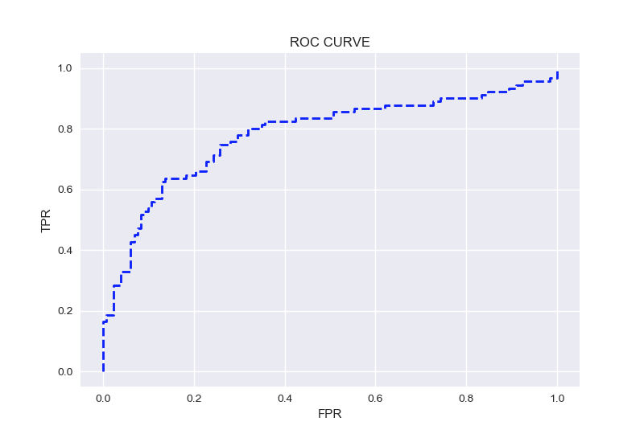
Results - ROC Curve

Slide 14
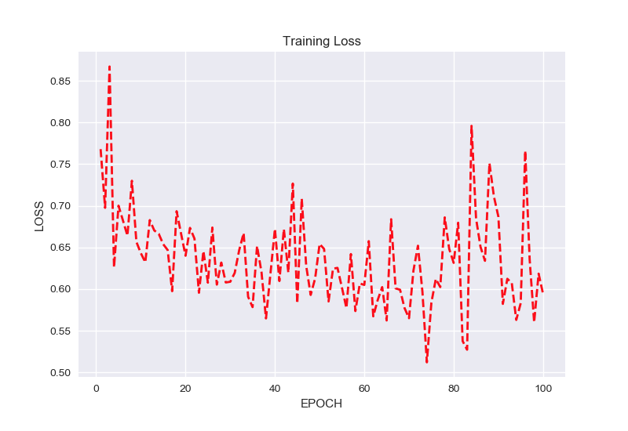
Results - Training Loss

Slide 15
DEMO

